Slide 1
Object Detection

Slide 2
Fast R-CNN
Fast R-CNN resembled the R-CNN technique in many ways, but improved on its detection speed while also increasing detection accuracy through two main changes:
﻿Instead of starting with the regions proposal module then the feature extraction module like R-CNN, Fast-RCNN proposes that we apply the CNN feature extractor first to the entire input image then propose regions. This way we only run one ConvNet over the entire image instead of 2000 ConvNets over 2000 overlapping regions.
﻿Extend the ConvNet to do the classification part as well by replacing the traditional machine learning algorithm, SVM, with a softmax layer. This way we have only one model to perform both tasks: 1) feature extraction and 2) object classification.

Slide 3
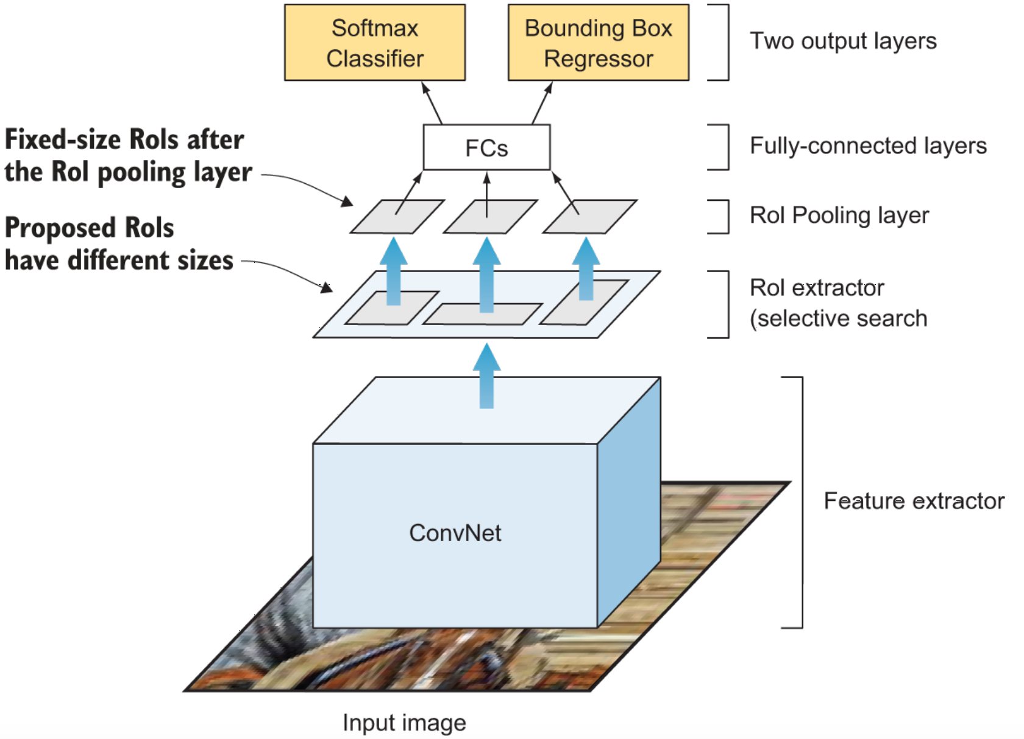
Fast R-CNN

Slide 4
Fast R-CNN
﻿As we can see from the image, Fast R-CNN is now generating region proposals based on the last feature map of the network, not from the original image itself like in R-CNN.
As a result, we can train just one ConvNet for the entire image.
﻿In addition, instead of training many different SVM algorithms to classify each object class, there is a single softmax layer that outputs the class probabilities directly.
Now we only have one neural net to train, as opposed to one neural net and many SVM’s.

Slide 5
Fast R-CNN
﻿The architecture of Fast R-CNN consists of the following modules:
﻿Feature extractor module - the network starts with a ConvNet to extract features from the full image.
﻿Regions of Interest (RoI) extractor - selective search algorithm to propose 2,000 regions candidates per image.
﻿RoI Pooling layer - this is a new component that was introduced in Fast R-CNN architecture to extract a fixed-size window from the feature map before feeding the RoIs to the fully-connected layers.
﻿Two-head output layer - the model branches into two heads: ﻿A softmax classifier layer that outputs a discrete probability distribution per RoI and a bounding-box regressor layer to predict offsets relative to the original RoI

Slide 6
Fast R-CNN - Disadvantages
﻿Fast R-CNN is much faster than R-CNN in both testing and training time.
Because at testing time, you don’t have to feed 2000 region proposals to the convolutional neural network every time.
Instead, a convolution operation is done only once per image and a feature map is generated from it.
Training is also faster because all of its components are in one CNN network: feature extractor, object classifier, and bounding-box regressor.

Slide 7
Fast R-CNN - Disadvantages
﻿However, there was just one big bottleneck remaining: the selective search algorithm for generating region proposals is very slow and it is generated separately by another model.
﻿The last step to achieve a complete end-to-end object detection system using deep learning is to find a way to combine the region proposal algorithm into our end-to-end deep learning network. This is what Faster R-CNN did as we will see next.

Slide 8
Faster R-CNN
﻿Similar to Fast R-CNN, the image is provided as an input to a convolutional network which provides a convolutional feature map.
Then, instead of using a selective search algorithm on the feature map to identify the region proposals, a network is used to predict the region proposals as part of the training process, called Region Proposal Network (RPN).
﻿The predicted region proposals are then reshaped using an RoI pooling layer then used to classify the image within the proposed region and predict the offset values for the bounding boxes.

Slide 9
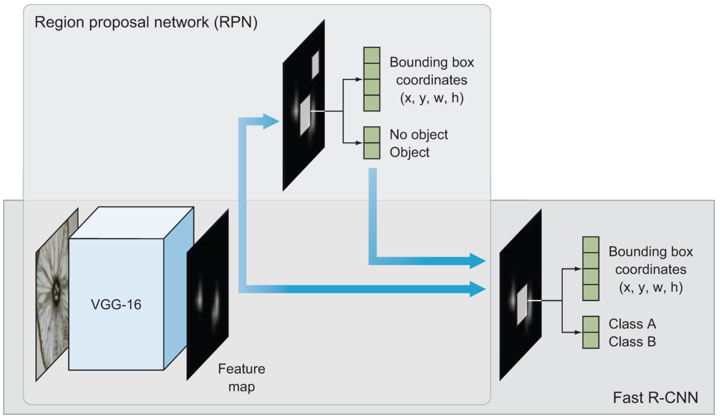
Faster R-CNN
﻿These improvements both reduce the number of region proposals and accelerate the test-time operation of the model to near real-time performance.

Slide 10
Faster R-CNN
﻿The architecture of Faster R-CNN can be described by two main networks:
﻿Region Proposal Network (RPN) - selective search is replaced by a ConvNet that to propose regions of interest (RoI) from the last feature maps of the feature extractor to be considered for investigations. RPN has two outputs; the “objectness score” (object or no object) and the box location
﻿Fast R-CNN - consists of the typical components of Fast R-CNN: ﻿Base network for Feature extractor, ﻿ROI pooling layer, and an ﻿Output layer comprising a classifier and bounding-box regressor.

Slide 11
Faster R-CNN
﻿As you can see in the Faster R-CNN architecture diagram, the input image is presented to the network and its features are extracted via a pre-trained CNN.
﻿These features, are sent to two different components of the Faster R-CNN architecture:
﻿The RPN to determine where in an image a potential object could be. At this point we do not know what the object is, just that there is potentially an object at a certain location in the image.
﻿ROI pooling to extract fixed-size windows of features

Slide 12
Faster R-CNN
﻿The output is then passed into two fully-connected layers: one for the object classifier and one for the bounding box coordinates predictions to obtain our final localizations.
﻿This architecture achieves an end-to-end trainable and the complete object detection pipeline where all the required components take place inside the network, including:
﻿Base network feature extractor
﻿Regions proposal
﻿ROI pooling
﻿Object classification
﻿Bounding box regressor

Slide 13
Recap of R-CNN family
﻿R-CNN: bounding boxes are proposed by the “selective search” algorithm, each of which is warped and features are extracted via a deep convolutional neural network, such as AlexNet, before a final set of object classifications and bounding box predictions are made with linear SVMs and linear regressors.
﻿Fast R-CNN: a simplified design with a single model, a region-of-interest pooling layer is used after the CNN to consolidate regions and the model predicts both class labels and regions of interest directly.
﻿Faster R-CNN: a fully end-to-end deep learning object detector. Faster R-CNN replaced the Selective Search algorithm to propose regions of interest with a Region Proposal Network (RPN) that interprets features extracted from the deep CNN and learns to propose regions-of-interest directly.

Slide 14
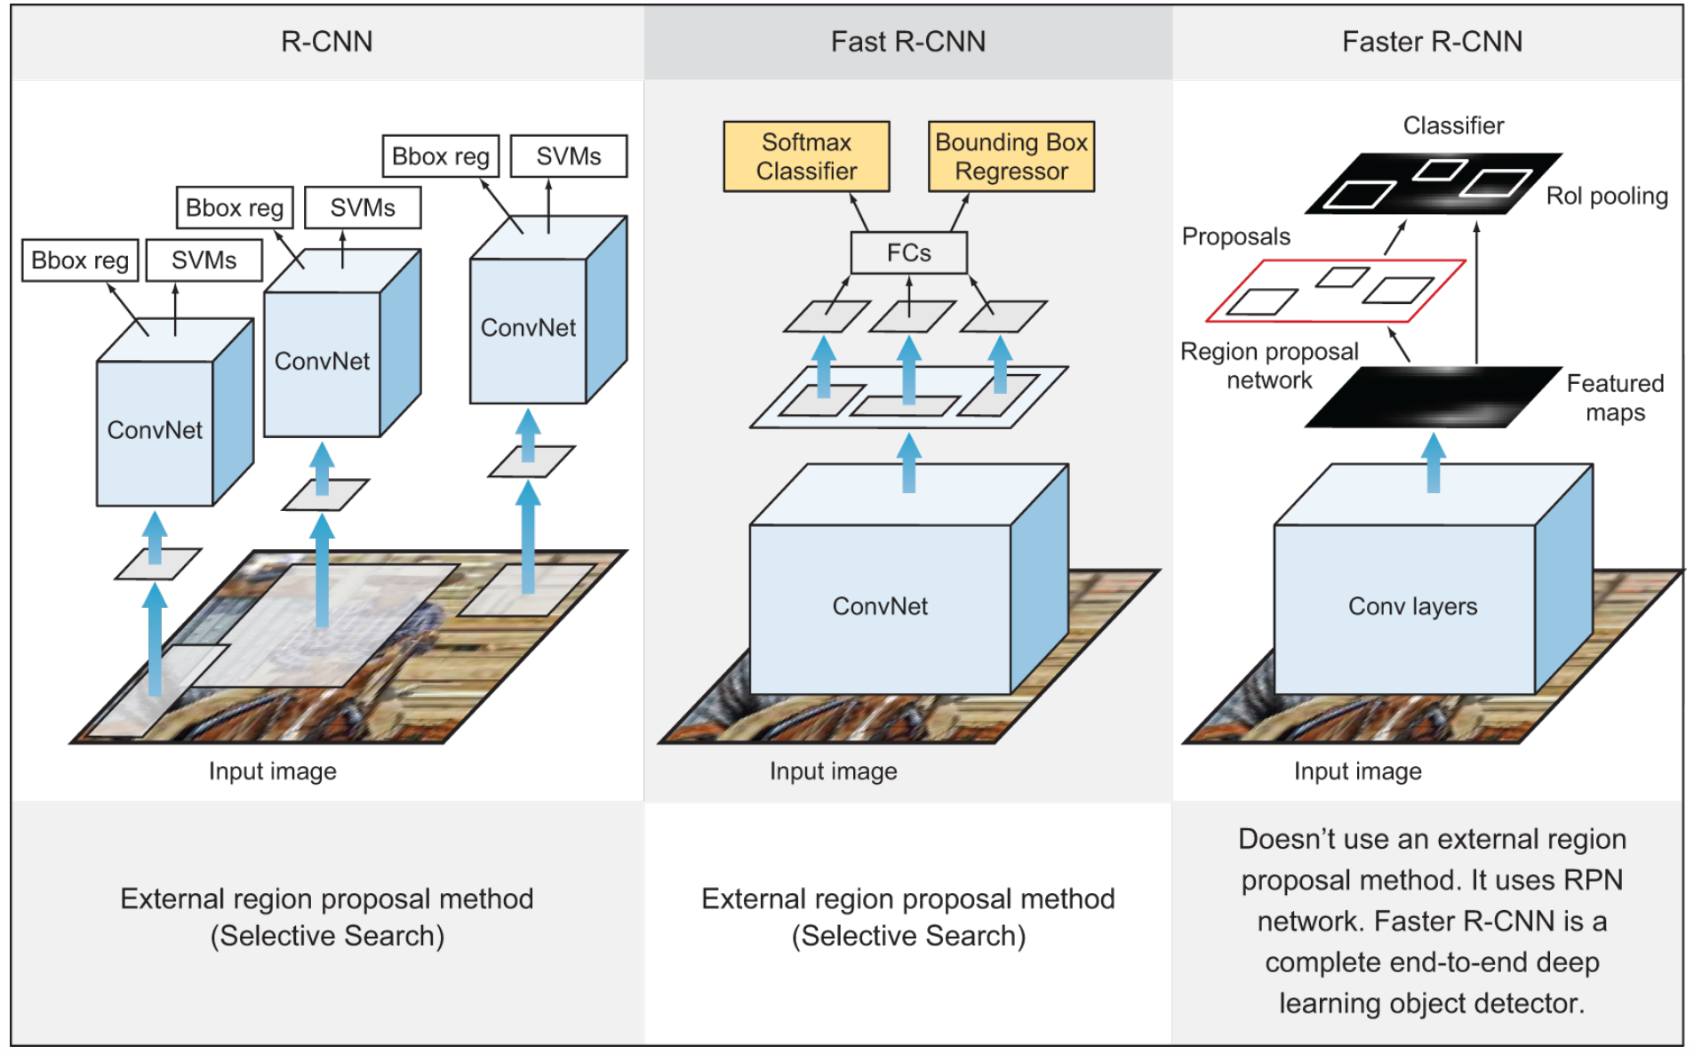
Recap of R-CNN family

Slide 15
﻿MULTI-STAGE VS. SINGLE-STAGE DETECTOR
﻿Models in the R-CNN family are all region-based. The detection happens in two stages, thus called two-stage detectors:
First, the model proposes a set of regions of interest by Selective Search or Regional Proposal Network (RPN). The proposed regions are sparse as the potential bounding box candidates can be infinite.
Then a classifier only processes the region candidates.

Slide 16
﻿MULTI-STAGE VS. SINGLE-STAGE DETECTOR
One-stage detectors take a different approach. They skip the region proposal stage and run detection directly over a dense sampling of possible locations. This is faster and simpler, but might potentially drag down the performance a bit.
One-stage object detector algorithms include Single-Shot Detection (SSD) and You Only Look Once (YOLO).
In general, single-stage detectors tend to be less accurate than two-stage detectors but are significantly faster.

